Slide 1
Session 4.4 JavaScript Important Functions, Keywords and BOM

Slide 2
Contents
JavaScript Number & Strings
JavaScript Date, Array and Boolean
JavaScript BOM
BOM Window, Screen and Location

Slide 3
Number Properties
MAX_VALUE
MIN_VALUE
NE GATIVE_INFINITY
POSITIVE_INFINITY
NaN property
isNaN() Method
Infinity property
isFinite() Method

Slide 4
MAX_VALUE
MAX_VALUE is a property of the JavaScript Number object. (Number.MAX_VALUE)
Returns the largest number possible in JavaScript.
It has the value of 1.7976931348623157e+308.
<script>
document.getElementById("demo"). innerHTML=Number.MAX_VALUE;
</script>
Output
1.7976931348623157e+308

Slide 5
MIN_VALUE
MIN_VALUE is a property of the JavaScript Number object. (Number.MIN_VALUE )
Returns the smallest number in JavaScript.
value of 5e-324.
Eg; x.MIN_VALUE, where x is a variable, will return undefined.
<script>
let x = 100;
document.getElementById("demo").innerHTML = x.MIN_VALUE;
</script>
Output
undefined

Slide 6
NaN property
Number.NaN returns NaN ("Not a Number")
<script>
let x = Number.NaN;
document.getElementById("demo").innerHTML = x;
</script>
//output = NaN

Slide 7
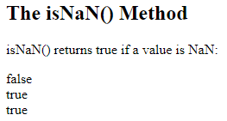
isNaN() Method
isNaN() returns true if a value is Not-a-Number.
Number.isNaN() returns true if a number is Not-a-Number.
<script>
let result = isNaN('123') + "<br>" +
isNaN('Hello') + "<br>" +
isNaN('2005/12/12');
document.getElementById("demo").innerHTML = result;
</script>
//output = false
true
true

Slide 8
Infinity Property
1.797693134862315E+308 is the limit of a JavaScript number.
<script>
let x = 1.797693134862315E+308;
let y = x * 1.001;
document.getElementById("demo").innerHTML = y;
</script>
//output = Infinity

Slide 9
isFinite() Method
isFinite() returns false if a value is Infinity, -Infinity, or NaN, otherwise true.
<script>
let result = isFinite(123);
document.getElementById("demo").innerHTML = result;
</script>
//output = true

Slide 10
Number Methods
toExponential(x) | Converts a number into an exponential notation
toFixed(x) | Formats a number with x numbers of digits after the decimal point
toPercision(x) | Formats a number to x length
toString( ) | Converts a Number object to a string
valueOf( ) | Returns the primitive value of a Number object

Slide 11
JavaScript eval() Method
eval() method evaluates a string of JavaScript code in the context of an object.
If the argument is an expression, eval() evaluates the expression.
Syntax:
eval(string)
Parameter Values : string
A JavaScript expression, variable, statement, or sequence of statements
Notes:
The eval() method evaluates or executes an argument.
If the argument is an expression, eval() evaluates the expression. If the argument is one or more JavaScript statements, eval() executes the statements.

Slide 12
JavaScript eval() Method
<script>
eval("x=10;y=20;document.write(x*y)");//200
document.write("<br>" + eval("2+2"));//4
document.write("<br>" + eval(x+17));//27
</script>

Slide 13
JavaScript Strings
You can put quotes inside a string by using the \ escape character
Important Properties
length( )
indexOf( ) / lastIndexOf( )
match( ) / replace( )
toUpperCase( ) / toLowerCase( )
split() /concat( )
substr( )

Slide 14
length()
<script>
var txt="Hello World!";
document.write("<p> The length of"+txt+"is"+txt.length+ "</p>");
var txt="ABCDEFGHIJKLMNOPQURSTUVWXYZ";
document.write("<p>"+txt.length+"</p>");
</script>

Slide 15

match( )
<script>
var str="Hello world!";
document.write(str.match("world")+"<br>");
document.write(str.match("World!")+"<br>");
document.write(str.match("world!"));
</script>

Slide 16
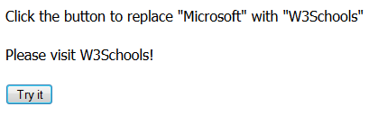
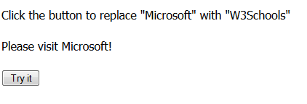
replace
<p>Click the button to replace "Microsoft" with "W3Schools"</p>
<p id="demo">Please visit Microsoft!</p>
<button onClick="myFunction()">Try it</button>
<script>
function myFunction()
{var str=document.getElementById("demo").innerHTML;
var n=str.replace("Microsoft","W3Schools");
document.getElementById("demo").innerHTML=n;
}
</script>

Slide 17
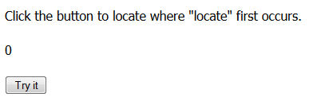
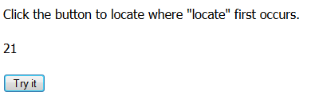
indexOf
<p id="p1">Click the button to locate where "locate" first occurs.</p>
<p id="p2">0</p>
<button onClick="myFunction()">Try it</button>
<script>
function myFunction()
{var str=document.getElementById("p1").innerHTML;
var n=str.indexOf("locate");
document.getElementById("p2").innerHTML=n+1;
}
</script>

Slide 18
split
<script>
function myFunction()
{
var str="a,b,c,d,e,f";
var n=str.split(",");
document.getElementById("demo").innerHTML=n[3];
}
</script>

Slide 19
Date in JavaScript
The Date object is used to work with dates and times.
There are four ways of initiating a date:
new Date( )//current date and time
new Date(milliseconds)//since 1970/01/01
new Date(dateString)
new Date (year, month, day, hours, minutes, seconds, milliseconds)

Slide 20
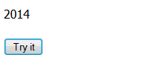
Date
<p id="demo">Click the button to display the full year of todays date.</p>
<button onClick="myFunction()">Try it</button>
<script>
function myFunction()
{var d=new Date();
var x=document.getElementById("demo");
x.innerHTML=d.getFullYear();
}
</script>

Slide 21
Date Methods
JavaScript is used to add a clock that displays the current time on your web page.
Method Function | What the Function Does
getMilliseconds() | Returns the milliseconds(from 0-999)
getHours() | Returns the current number of hours into the day: (0-23)
getMinutes() | Returns the current number of minutes into the hour: (0-59)
getSeconds() | Returns the current number of seconds into the minute: (0-59)
getDay() | Returns the number of days into the week: (0-6)
getMonth() | Returns the number of months into the year: (0-11)
getYear() | Returns the number of years into the century: (0-99)
getDate( ) | Returns the day of the month (from 1-31)
getFullYear( ) | Returns the year (four digits)

Slide 22
Creating a JavaScript Clock on page.
<script type="text/javascript">
// This function gets the current time and injects it into the DOM
function updateClock() {
// Gets the current time
var now = new Date();
// Get the hours, minutes and seconds from the current time
var hours = now.getHours();
var minutes = now.getMinutes();
var seconds = now.getSeconds();
// Format hours, minutes and seconds
if (hours < 10) {
hours = "0" + hours;
}

Slide 23
Creating a JavaScript Clock on page.
if (minutes < 10) {
minutes = "0" + minutes;
}
if (seconds < 10) {
seconds = "0" + seconds;
}
// Gets the element we want to inject the clock into
var elem = document.getElementById('clock');
// Sets the elements inner HTML value to our clock data
elem.innerHTML = hours + ':' + minutes + ':' + seconds;
}
</script>

Slide 24
Creating a JavaScript Clock on page.
<!--
This is the key to making the clock function.
When the page loads, it calls the javascript function "setInterval()",
which will call our function "updateClock()" once every 200 milliseconds.
-->
<body onload="setInterval('updateClock()', 200);">
<!-- This is the container for our clock, it can be any HTML element. -->
<h1 id="clock"></h1>
</body>

Slide 25
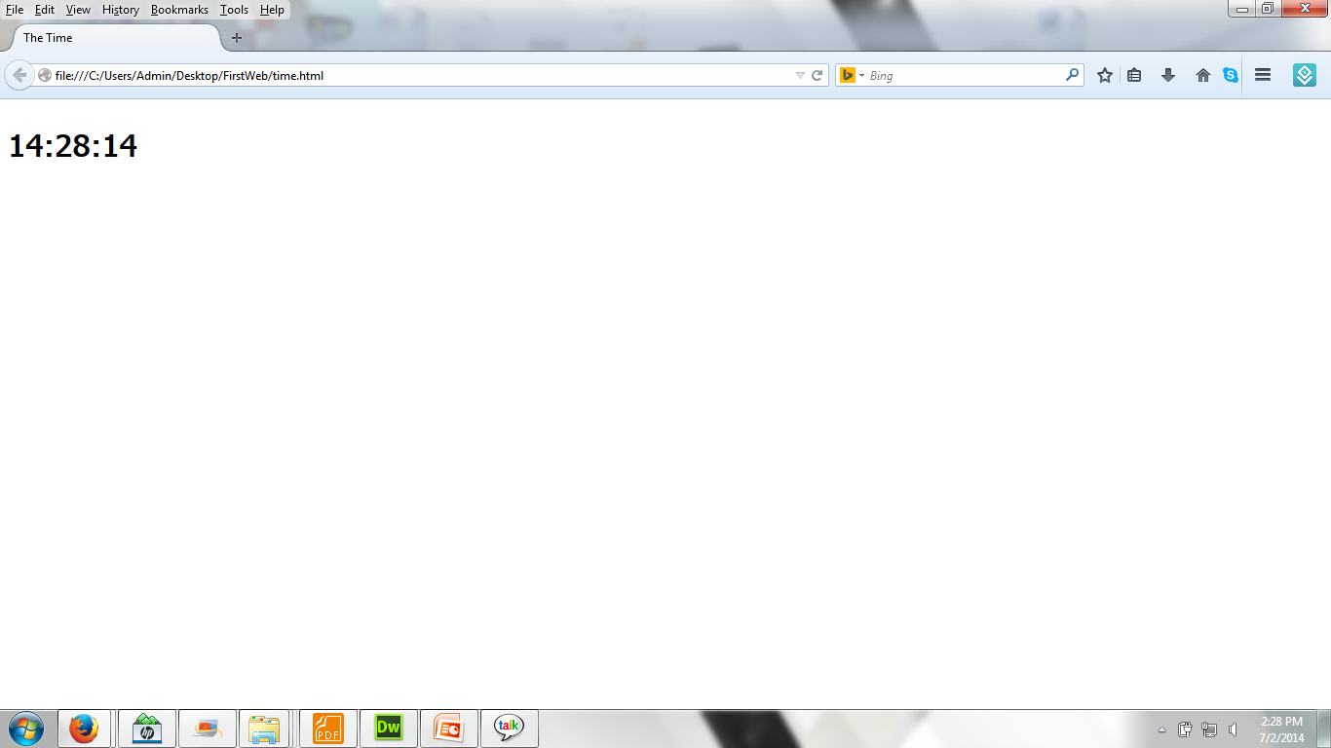
Creating a JavaScript Clock on page.

Slide 26
Arrays in JavaScript
Method | Description
concat() | Joins two or more arrays, and returns a copy of the joined arrays
indexOf( ) | Search the array for an element and returns its position
join( ) | Joins all elements of an array into a string
lastIndexOf( ) | Search the array for an element, starting at the end, and returns its position
pop() | Removes the last element of an array, and returns that element
push() | Adds new elements to the end of an array, and returns the new length
reverse( ) | Reverses the order of the elements in an array
shift( ) | Removes the first element of an array, and returns that element
slice( ) | Selects a part of an array, and returns the new array
sort( ) | Sorts the elements of an array

Slide 27
concat()
<p id="demo"></p>
<button onClick="myFunction()">Try it</button>
<script>
function myFunction()
{
var hege = ["Cecilie", "Lone"];
var stale = ["Emil", "Tobias", "Linus"];
var kai = ["Robin"];
var children = hege.concat(stale,kai);
var x=document.getElementById("demo");
x.innerHTML=children;
}
</script>

Slide 28
join()
<p id="demo"></p>
<button onClick="myFunction()">Try it</button>
<script>
function myFunction()
{
var fruits= ["Banana", "Orange", "Apple", "Mango"];
var x=document.getElementById("demo");
x.innerHTML=fruits.join();
}
</script>

Slide 29
reverse( )
<p id="demo"></p>
<button onClick="myFunction()">Try it</button>
<script>
var fruits= ["Banana", "Orange", "Apple", "Mango"];
function myFunction()
{
fruits.reverse();
var x=document.getElementById("demo");
x.innerHTML=fruits;
}
</script>

Slide 30
sort( )
<p id="demo"></p>
<button onClick="myFunction()">Try it</button>
<script>
var fruits= ["Banana", "Orange", "Apple", "Mango"];
function myFunction()
{fruits.sort();
var x=document.getElementById("demo");
x.innerHTML=fruits;
}
</script>

Slide 31
shift( )
<p id="demo"></p>
<button onClick="myFunction()">Try it</button>
<script>
var fruits= ["Banana", "Orange", "Apple", "Mango"];
function myFunction()
{fruits.shift();
var x=document.getElementById("demo");
x.innerHTML=fruits;
}

Slide 32
JavaScript BOM
The Browser Object Model( BOM ) allows JavaScript to “talk to” the browser.
Following things are handled:
Window
Screen
Location
History
Cookies etc……

Slide 33
Managing Browser Window
The window object is supported by all browsers.
Even the document object (of the HTML DOM) is a property of the window object.

Slide 34
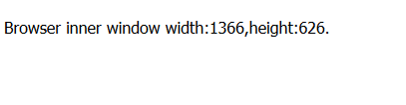
window
<p id="demo"></p>
<script>
var w=window.innerWidth||document.documentElement.clientWidth||document.body.clientWidth;
var h=window.innerHeight||document.documentElement.clientHeight||document.body.clientHeight;
x=document.getElementById("demo");
x.innerHTML="Browser inner window width:"+w+",height:"+h+".";
</script>

Slide 35
Window Properties
window.open( )- open a new window
window.close( )-close the current window
window.moveTo( )-move the current window
window.resizeTo( )-resize the current window

Slide 36
window.open
<script>
function openWin()
{myWindow=window.open("","","width=200","height=100");
myWindow.document.write("<p>This is 'myWindow'</p>");
myWindow.focus();
}
</script>
<input type="button" value="Open Window" onClick="openWin()“/>

Slide 37
Browser Window Screen
The window.screen object contains information about the user’s screen.
Some properties:
screen.availWidth – available screen width
screen.availHeight-available screen height

Slide 38
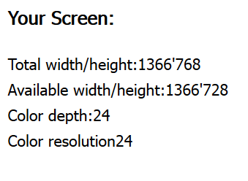
Browser Window Screen
<script>
document.write("Total width/height:");
document.write(screen.width+"'"+screen.height);
document.write("<br>");
document.write("Available width/height:");
document.write(screen.availWidth+"'"+screen.availHeight);
document.write("<br>");
document.write("Color depth:");
document.write(screen.colorDepth);
document.write("<br>");
document.write("Color resolution");
document.write(screen.pixelDepth);
</script>

Slide 39
Window Location
The window.location object can be used to get the current page address (URL) and to redirect the browser to a new page.
location.hostname returns the domain name of the web host
location.pathname returns the filename of the current page
location.port returns the port of the web host(80 or 443)
location.protocol returns the protocol used (http:// or https://)

Slide 40
Window Location
<script>
function newDoc()
{
window.location.assign("http://www.google.com");
}
</script>
<input type="button" value="Load new document" onClick="newDoc()">

Slide 41
Window Location
<script>
function open_win()
{ window.open("http://www.google.com","_blank","toolbar=yes,location=yes,directories=no,status=no,menubar=yes,scrollbars=yes,resizable=no,copyhistory=yes,width=400,height=400");
}</script>
<form>
<input type="button" value="Open Window" onClick="open_win()">
</form>

Slide 42
Window History
The window.history object contains the browser history.
Some methods:
history.back( )- same as clicking back in the browser
history.forward( )-same as clicking forward in the browser

Slide 43
Some Useful Tips
Creating a Popup and focus and resize or move it
Printing a Window
Creating a javascript counter
Reload the Current Page

Slide 44
resizeTo()
<script>
var w;
function openwindow()
{ w=window.open("","","width=100,height=100");
w.focus();}
function myFunction()
{ w.resizeTo(500,500);
w.focus();}
</script>
<input type="button" value="Create Window" onClick="openwindow()"/>
<input type="button" value="Resize Window" onClick="myFunction()"/>

Slide 45
window.move
<script>
function moveWin()
{myWindow.moveTo(0,0);
myWindow.focus();
}
</script>
<input type="button" value="Open Window" onClick=“moveWin()“/>

Slide 46
window print()
<script>
function printpage()
{window.print();
}
</script>
<input type="button" value="Print this page" onClick="printpage()"/>

Slide 47
Thank you!

